Slide 1
Module 7
Tool-Augmented Prompting
API-based prompting, Function Calling, Plug-in Tool Integration ,Retrieval Augmented Generation.

Slide 2
Tool-Augmented Prompting
Tool-Augmented Prompting (TAP) is a prompting paradigm in which a large language model (LLM) is explicitly guided to use external tools—such as search engines, calculators, databases, code interpreters, APIs, or domain-specific software—during its reasoning or response generation process.
Instead of relying solely on its internal parameters (pretrained knowledge), the model is prompted to:
Recognize when external information or computation is required
Select an appropriate tool
Generate structured inputs for that tool
Incorporate the tool’s output into the final response

Slide 3
In simple terms, Tool-Augmented Prompting extends the model’s capabilities by combining natural language reasoning + external functional tools.
Web Search Augmentation : “Find the latest AI policy updates in India and summarize them.”
Web search API
Why: The model retrieves up-to-date information instead of relying only on training data.
User → LLM → Web Search Tool → Retrieved Articles → LLM Summary → Output

Slide 4
Calculator Tool (Mathematical Accuracy)
Prompt:
“If a company’s revenue grows 12% annually for 5 years starting from ₹5 crore, what is the final amount?”
Tool Used: Calculator / Python Why: Ensures precise compound interest calculation.
Instead of mental math: LLM → Calls Calculator Tool → Returns exact value → Formats explanation

Slide 5
Database Retrieval (RAG – Retrieval Augmented Generation)
Prompt:
“Summarize Chapter 3 of my uploaded climate research paper.”
Tool Used: Document Retriever / Vector Database Why: Fetches relevant sections from the uploaded document.
Flow: Query → Embedding Search → Relevant Paragraphs Retrieved → LLM Generates Summary

Slide 6
Code Execution Tool
Prompt:
“Plot the temperature trends from this CSV file.”
Tool Used: Python Code Interpreter Why: Executes real data visualization instead of guessing.
LLM writes Python → Executes → Returns chart

Slide 7
API Tool (Weather Example)
Prompt:
“What’s the weather in Hyderabad right now?”
Tool Used: Weather API Why: Gets real-time weather instead of outdated info.

Slide 8
Knowledge Graph Query
Prompt:
“Who collaborated most frequently with A.R. Rahman?”
Tool Used: Knowledge Graph Query Why: Structured relational data gives precise answer.

Slide 9
Multi-Step Tool Chain (Agentic Workflow)
Prompt:
“Analyze stock performance of TCS over last 6 months and give investment insight.”
Tools Used:
Financial API
Python for statistical analysis
Plotting library
Flow: Retrieve data → Compute moving average → Generate graph → Provide explanation

Slide 10
Scientific Tool Usage
Prompt:
“Run a regression model on this climate dataset and interpret results.”
Tool Used: ML library (Scikit-learn via Python tool) Why: Performs actual statistical modeling.

Slide 11
Translation + Fact Verification
Prompt:
“Translate this French policy document and verify key claims.”
Tools Used:
Translation model
Web verification tool

Slide 12
Enterprise Example – Customer Support
Prompt:
“Check order #78439 and update delivery status.”
Tools Used:
CRM Database
Shipping API

Slide 13
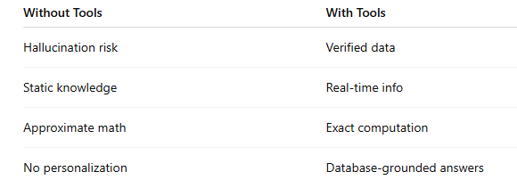
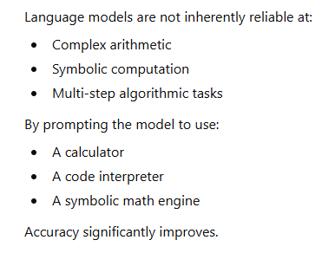
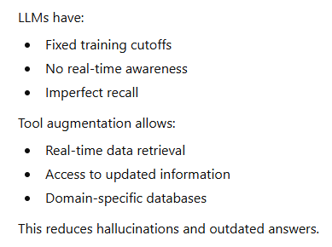
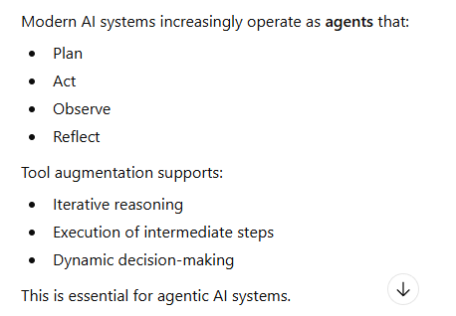
Tool-Augmented Prompting Matters
Improving Numerical and Logical Accuracy
Overcoming Knowledge Limitations
Enabling Complex Multi-Step Workflows

Slide 14
Conceptual Flow of Tool-Augmented Prompting User Query → LLM Reasoning → Tool Selection → Tool Execution → Result Integration → Final Answer
Reducing Hallucination
Instead of guessing:
The model verifies through search
It checks facts via retrieval
It queries structured knowledge bases
This increases reliability in scientific, legal, financial, and medical domains.
Expanding Functional Capabilities
With tools, an LLM can:
Execute code
Analyze datasets
Generate visualizations
Access enterprise systems
Interact with software environments
This transforms a static chatbot into an interactive computational system.

Slide 15
Add-on
In Agentic AI Systems
Tool-augmented prompting enables:
Autonomous planning
Multi-step reasoning
External action execution
Self-verification loops
It is foundational for:
RAG systems
Autonomous agents
Enterprise AI copilots
Scientific AI workflows

Slide 16
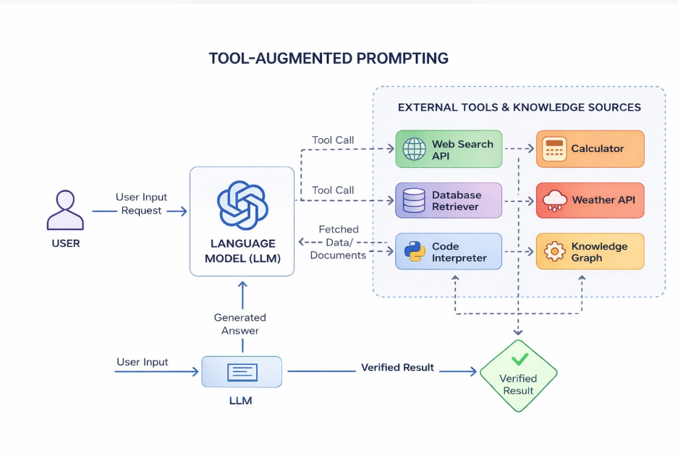
Architecture Diagram of TAP

Slide 17
Components of TAP
Task Understanding & Intent Recognition
The system first interprets:
User intent
Task complexity
Required knowledge type (factual, computational, procedural)
This stage determines whether internal reasoning is sufficient or tool usage is necessary.
Reasoning & Planning Module
The model decomposes the task into:
Sub-tasks
Ordered reasoning steps
Tool-dependent vs non-tool steps
This planning layer is critical in agentic workflows where multi-step execution is required.
Tool Registry / Tool Library
A structured catalog of available tools, such as:
Web search APIs
Calculators
Code interpreters
Databases
Domain-specific APIs
Each tool is defined with:
Input schema
Output format
Execution constraints
Tool Selection Mechanism
The model decides:
Which tool to use
When to use it
Whether multiple tools are required
Selection may be rule-based, prompt-guided, or learned via reinforcement learning.
Tool Invocation Interface
The model generates: Structured arguments, API calls, Code snippets
This component converts natural language reasoning into machine-readable tool commands.
Observation & Feedback Integration
Tool outputs are:
Parsed
Validated
Incorporated back into the reasoning chain
The model updates its internal state using the returned evidence.
Response Synthesis
The final answer is generated by:
Combining internal reasoning
Integrating tool outputs
Structuring information clearly for the user
This ensures coherence, accuracy, and completeness.
User Input → Intent Detection → Planning → Tool Selection → Tool Invocation → Execution → Feedback Integration → Final Output

Slide 18
Architectural Workflow of Tool-Augmented Prompting (TAP) - User Query Processing
Key Functions:
Natural language understanding (NLU)
Intent detection
Task classification (factual, computational, analytical, multi-step)
Context extraction (entities, constraints, goals)
Complexity estimation

Slide 19
Decision Layer- reasoning and orchestration core.
Key Functions:
Task decomposition into sub-tasks
Planning and sequencing
Tool selection strategy
Confidence estimation
Error detection triggers
Subcomponents:
Reasoning engine
Tool selector
Policy controller (rule-based / learned policy)
Memory/context tracker

Slide 20
External Tool Invocation
Key Functions:
Structured API calls
Code generation for computation
Database queries
Web search retrieval
Software/system interaction

Slide 21
Response Synthesis
This is the integration and generation layer.
Key Functions:
Combine internal reasoning + tool output
Cross-check consistency
Refine answer clarity
Generate human-readable response
Provide explanations if required
Objective:
Produce:
Accurate
Context-aware
Coherent
Verifiable answer
Final Output:
Structured natural language response (optionally with citations, calculations, or trace explanations)

Slide 22
API-Based Prompting
API-based prompting refers to interacting with Large Language Models (LLMs) through structured Application Programming Interfaces (APIs). Instead of manually entering prompts, developers send structured requests (JSON format) to the model via HTTP calls.
Prompt → LLM → API Call → API Response → LLM Processes → Final Output
The model:
Understands the user request
Decides which API to call
Sends structured parameters
Receives JSON/data
Converts it into human-readable response

Slide 23
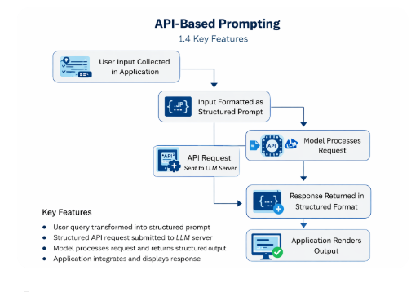

Slide 24
An API (Application Programming Interface) allows different software systems to communicate.
Weather services
Payment gateways
Banking systems
University databases
Stock market feeds

Slide 25
Simpe Example
Example 1: Weather Query
User Prompt:
“What is the current weather in Hyderabad?”
Process:
LLM detects need for real-time data
Calls Weather API
Receives JSON response
Converts into readable sentence
Output:
“The current temperature in Hyderabad is 29°C with moderate humidity.”

Slide 26
Climate Intelligence Decision Agent
Prompt : “Assess flood risk for Hyderabad for next 7 days and suggest mitigation strategy.”
APIs Used
Weather Forecast API
Satellite Rainfall API
River Water Level API
Urban Drainage GIS API
Processing Steps
Retrieve 7-day rainfall forecast
Retrieve river level trends
Retrieve soil saturation index
Run flood risk scoring model
Generate structured advisory Risk Level: High
Expected Peak Rainfall: 120 mm
Suggested Actions:
Drainage clearance
Low-lying area alerts
Reservoir pre-release

Slide 27
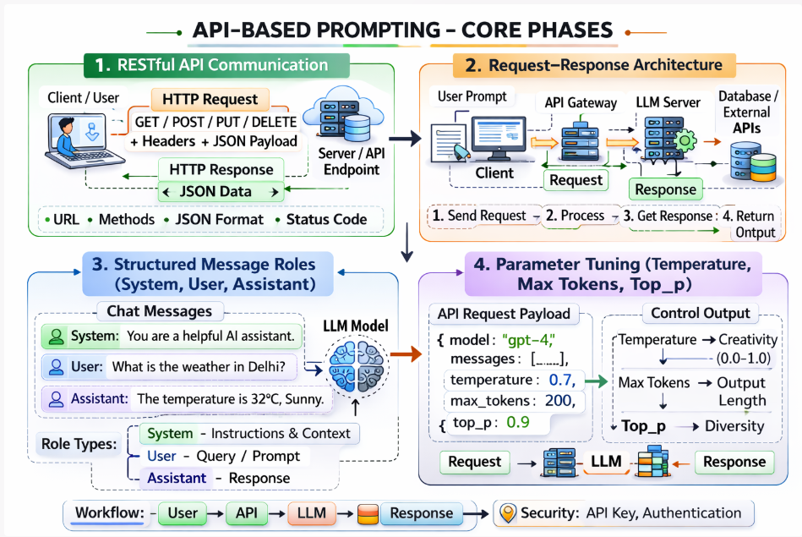

Slide 28
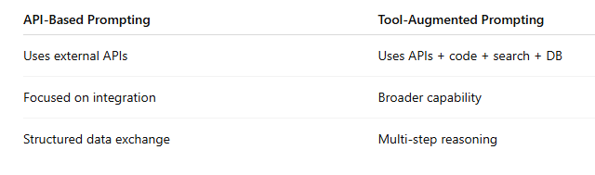
Types of APIs Used
REST APIs – Most common (JSON-based)
GraphQL APIs – Flexible queries
SOAP APIs – Enterprise legacy systems
Internal Enterprise APIs – CRM, ERP, HR systems

Slide 29
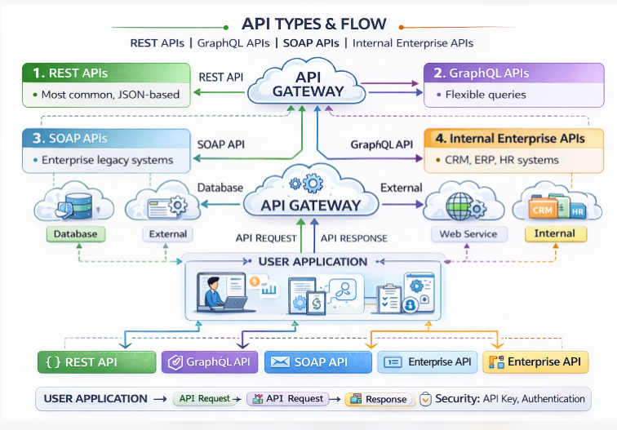

Slide 30
Function Calling in Prompt Engineering
Function calling in prompt engineering is a structured mechanism that allows a Large Language Model (LLM) to generate machine-readable instructions to call external functions or tools instead of directly producing a final natural language answer.
Rather than answering purely in text, the model can:
Detect when a task requires external execution
Select an appropriate predefined function
Generate structured arguments (usually in JSON format)
Trigger backend logic or APIs
Incorporate the function result into the final response

Slide 31
Need of Function Calling
Traditional prompting:
User asks → Model generates text answer
Function calling:
User asks → Model decides a function is needed → Model generates structured function call → Backend executes → Result returned → Model generates final answer
It transforms an LLM from a text generator into an action-oriented system component.

Slide 32
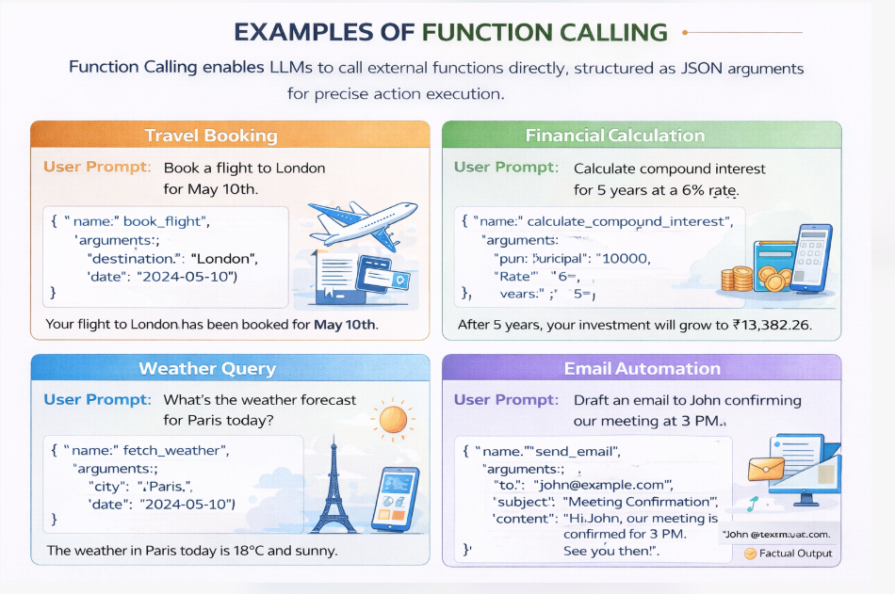

Slide 33
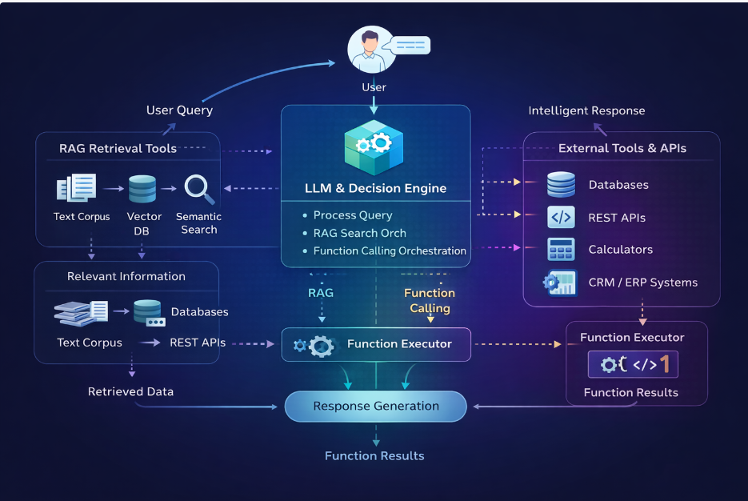

Slide 34
Function Calling
Function Schema Definition
This defines the function the model is allowed to call. It acts as a contract between the LLM and the backend system.
🔹 a) Name
Unique identifier of the function
Should clearly describe the action
Example: get_weather, book_flight, calculate_tax
🔹 b) Description
Explains what the function does
Helps the model understand when to call it
Should be clear and specific
Example:
"Fetches the current weather information for a given city."

Slide 35
c) Parameters (JSON Schema)
Defines the expected inputs
Uses structured JSON format
Includes:
type (string, number, object, array)
properties
required fields
Optional validation rules

Slide 36
Structured Output
Instead of plain text, the model returns structured JSON.
JSON Arguments
When the model decides to call a function, it outputs:
Decision Capability
This is the intelligence layer.
The model:
Understands user intent
Checks available functions
Decides whether to:
Respond normally (text)
OR call a function

Slide 37
Plug-in Tool Integration
Plug-in tools in prompt engineering are external tools, APIs, or systems that a Large Language Model (LLM) can access during a conversation to perform tasks beyond text generation.
Instead of only generating responses from its training data, the model can:
Retrieve real-time data
Perform calculations
Access databases
Execute code
Interact with enterprise systems
This makes AI systems more powerful, accurate, and action-oriented.

Slide 38
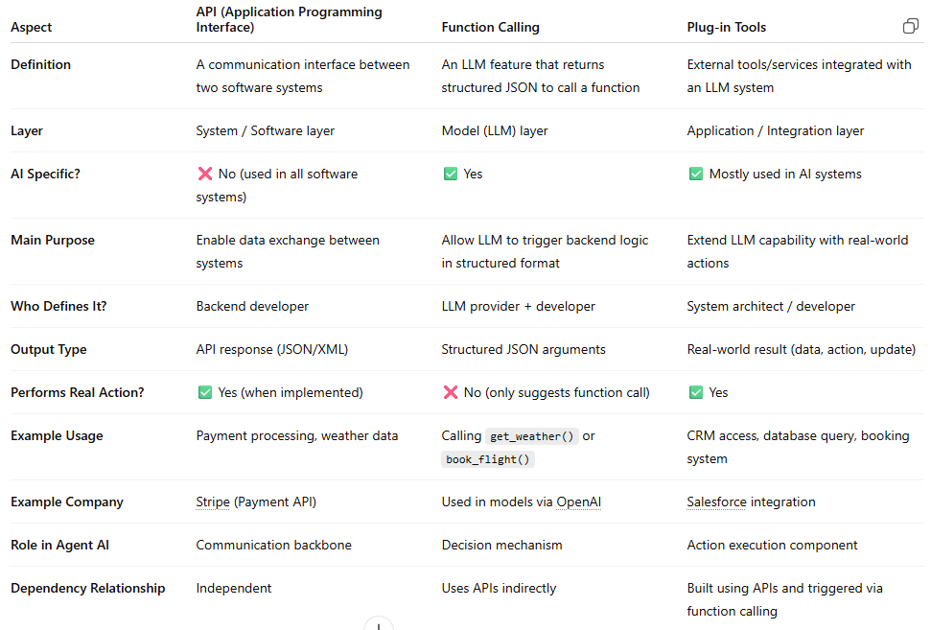

Slide 39
RAG (Retrieval-Augmented Generation)
Retrieval-Augmented Generation (RAG) is an AI technique where a Large Language Model (LLM) retrieves relevant information from external knowledge sources before generating a response.
Instead of answering only from its training data, the model:
Retrieves relevant documents
Injects them into the prompt
Generates an answer grounded in that data

Slide 40
RAG Workflow
User Query
↓
Query Sent to Retriever
↓
Search in Vector Database
↓
Relevant Documents Retrieved
↓
Documents Added to Prompt
↓
LLM Generates Answer
↓
Final Response to User

Slide 41
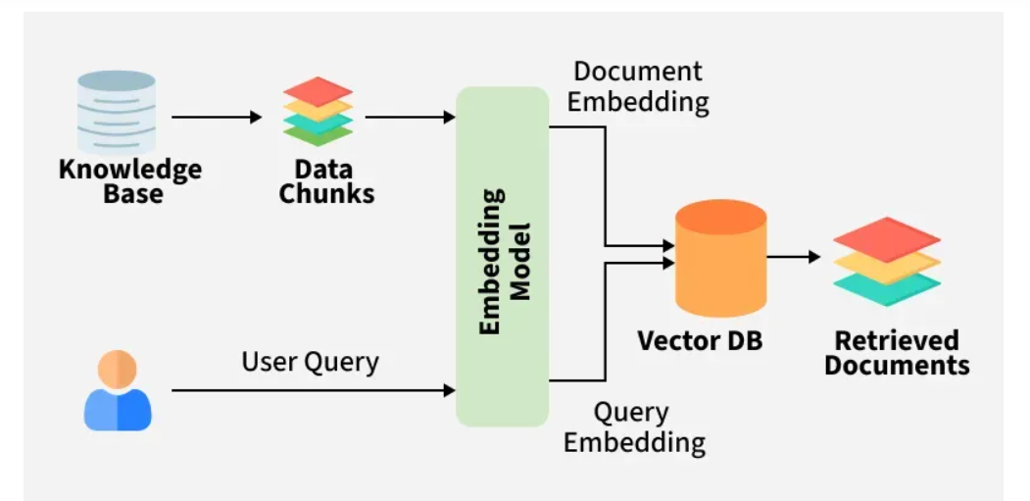

Slide 42
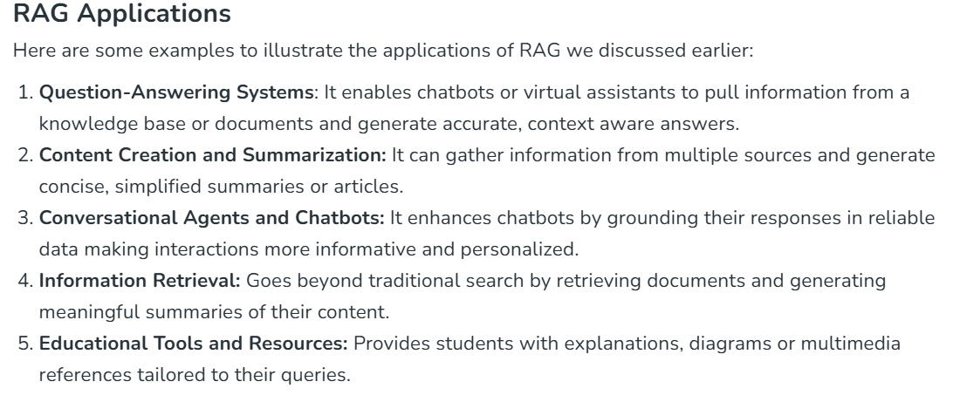

Slide 43
